Slide 1


RFID Smart Access & Attendance System
ESP8266 • RC522 • LCD 16X2 • BUZZER • LEDS • JUMPER WIRES

Slide 2

System Foundations
Combining wireless frequency identification, microcontrollers, and multi-modal feedback for next-gen physical security.

Slide 3



Problem Statement & Objectives
The Problem
Project Objectives
Manual Logging Issues: Paper-based attendance registries are slow, vulnerable to proxy entries, and prone to human error.
Instant UID Authentication: Securely read and parse 13.56 MHz RFID tags using the MFRC522 module under 300ms.
Clear Character Display: Provide real-time operational feedback using an LCD 16x2 display (via I2C interface).
Lack of Real-Time Audit: Traditional mechanical keys offer zero digital audit trail or real-time entry monitoring.
Audio-Visual Feedback: Trigger instant Green/Red LED indicators and active piezo buzzer beeps upon scanning.
No Visual/Audio Status: Basic RFID readers lack clear onboard visual status displays and audio confirmations for users.

Slide 4












Core Hardware Architecture Stack
ESP8266 NodeMCU
RC522 RFID Reader
LCD 16x2 Display
Main 32-bit Wi-Fi MCU driving system logic, processing tag UIDs, and enabling cloud logging capability.
13.56 MHz High-frequency contactless transceiver module communicating via SPI protocol.
Alphanumeric display with I2C backpack for real-time status alerts ("Access Granted / Denied").
Active Buzzer
Status LEDs
Jumper Wires & Rails
Provides distinct frequency tone alerts for successful scans vs unauthorized intrusion attempts.
Dual LED indicators (Green for Granted, Red for Denied) giving instant visual status at a glance.
High-grade Dupont Male-to-Female/Male-to-Male jumper wires ensuring stable SPI, I2C, and GPIO links.

Slide 5

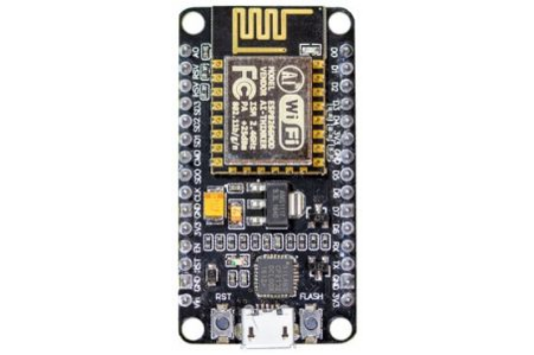
Microcontroller: ESP8266 NodeMCU
The ESP8266 NodeMCU serves as the brain of the access control system, managing peripheral communication and Wi-Fi network telemetry.
Processor Core: Tensilica L106 32-bit RISC microprocessor running at 80/160 MHz.
Wireless Networking: Integrated 802.11 b/g/n Wi-Fi transceiver for IoT cloud syncing.
Peripheral Support: Hardware SPI for RC522, I2C for LCD 16x2, and general GPIOs for signaling.
Operating Voltage: 3.3V power domain with built-in USB power regulator.

Slide 6
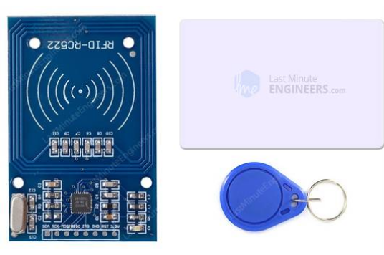
RFID Sensing: MFRC522 Transceiver
The MFRC522 is a highly integrated contactless reader/writer IC operating on the 13.56 MHz communication band.
Operating Frequency: 13.56 MHz ISO/IEC 14443 A / MIFARE standard.
Host Interface: SPI (Serial Peripheral Interface) for high-speed data transfer to ESP8266.
Read Range: Up to 50mm distance, ideal for quick contactless card swipes.
UID Parsing: Extracts unique 4-byte or 7-byte factory hardware identification codes.

Slide 7

Visual Interface: LCD 16x2 Module
The LCD 16x2 character display provides explicit user feedback at the entryway, displaying welcome messages or access rejection warnings.
Display Capacity: 16 characters across 2 rows with adjustable LED backlighting.
I2C Serial Adapter: Utilizes PCF8574 I2C expansion module to reduce pin usage from 6 GPIOs down to just 2 lines (SDA & SCL).
Dynamic Text Refresh: Instantly displays user name upon authorization or "Access Denied" for unknown UIDs.
Low Power Consumption: Consumes minimal current, making it ideal for continuous wall-mounted entry stations.

Slide 8

Hardware Interfacing
Jumper Wires & Circuit Assembly
Reliable hardware connections are critical for high-speed SPI signal integrity and low noise. High-grade Dupont jumper wires link the ESP8266 controller to the RC522 RFID reader, LCD 16x2 display, active buzzer, and LED indicators.
Common ground planes and regulated 3.3V/5V rails prevent voltage spikes and signal drops during active RFID card detection and buzzer sound triggering.

Slide 9


Pin Interfacing & Mapping Table
Peripheral Component | Module Pin | ESP8266 GPIO Pin | Communication Protocol / Type
RC522 RFID Reader | SDA (SS) / SCK / MOSI / MISO | GPIO15 (D8) / GPIO14 (D5) / GPIO13 (D7) / GPIO12 (D6) | SPI Protocol
RC522 RFID Reader | RST (Reset) / GND / 3.3V | GPIO0 (D3) / GND / 3.3V Pin | Power & Control
LCD 16x2 Display (I2C) | SDA / SCL / VCC / GND | GPIO4 (D2) / GPIO5 (D1) / 5V / GND | I2C (0x27 / 0x3F)
Active Buzzer | Positive (+) Pin / GND | GPIO2 (D4) / GND | Digital Output (PWM Tone)
Green & Red LEDs | Anodes (+) via 220Ω / GND | GPIO16 (D0) & GPIO0 (D3) / GND | Digital GPIO Output

Slide 10




System Operational Sequence
2. UID Verification
4. Audio-Visual Alert
ESP8266 receives UID via SPI and checks against authorized memory database or database server.
ESP8266 triggers Green LED + single short beep for authorized entry, or Red LED + long alarm beep.
1. Card Swipe
3. LCD Refresh
User taps 13.56 MHz card near RC522. RFID reader energizes tag and extracts unique hardware UID.
LCD 16x2 via I2C displays "Access Granted: Name" or "Access Denied: Invalid Card".

Slide 11
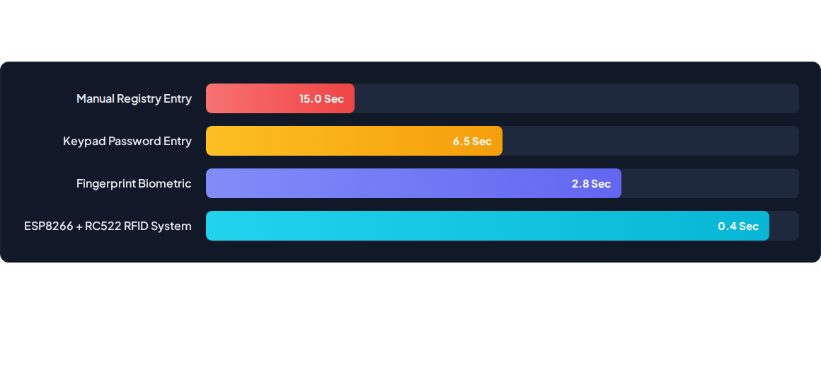
System Speed & Efficiency Metrics
The RFID + ESP8266 architecture achieves sub-second contactless verification (0.4s average authentication delay), drastically reducing entryway queues.

Slide 12
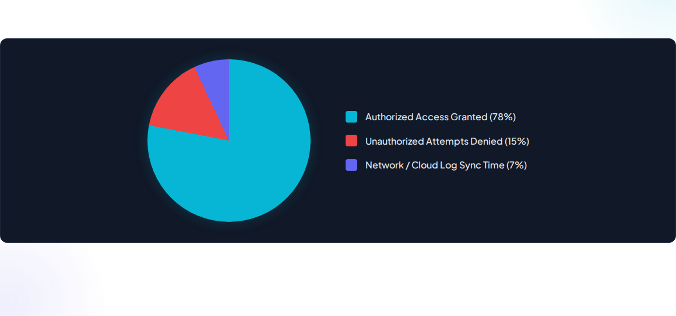
Access Verification Distribution
Real-world operational telemetry showing fast local decision making with background cloud attendance logging over Wi-Fi.

Slide 13

Key Performance Highlights
Reliable & Low-Cost Embedded Architecture
<0.5s
By leveraging the ESP8266's fast hardware SPI and hardware I2C modules alongside dedicated digital interrupt pins, the system guarantees zero user lag during peak access hours.
Dual feedback via the 16x2 LCD display and active buzzer ensures zero ambiguity for users attempting entry.
Total Scan-to-Alert Latency

Slide 14





Real-World Deployment Use Cases
Corporate Office Entry
Research Lab Security
School & University Halls
Automated staff clock-in/clock-out tracking with instant digital logging and monthly attendance reporting.
Restricted access control allowing only authorized personnel into high-containment chemical or server rooms.
Classroom and examination hall attendance tracking, replacing manual roll calls with contactless RFID tapping.

Slide 15

Questions & Discussion
Thank you for your time and attention!
IoT & Embedded Systems • RFID Access & Attendance System

Slide 16




Image Sources
https://www.make-it.ca/wp-content/uploads/2021/09/nodemcu-esp8266-small-162x300-1.jpg
Source: www.make-it.ca
https://lastminuteengineers.com/wp-content/uploads/arduino/RC522-RFID-Reader-Writer-Module-with-Tag-Card-and-FOB-Key-Tag.jpg
Source: lastminuteengineers.com
https://sharvielectronics.com/wp-content/uploads/2020/02/16%C3%972-LCD-Display-Blue-Backlight1.jpg
Source: sharvielectronics.com
https://diysmartlab.com/wp-content/uploads/2026/05/jumper-wires-.webp
Source: diysmartlab.com

